Slide 1
How to Use the Family and Children’s Trust Fund (FACT) Research Portal to
Identify and Target Program Needs
April 2016
CSA Conference

Slide 2
Introductions
Presenters
Nicole Poulin, Executive Director, FACT
Rebecca Hjelm, Senior Research Associate, FACT
Joyce Moran, Executive Officer, Southern VA Child Advocacy Center
Attendees
Notes:
- Do you work for a public or private entity?
- Do you do clinical or program management work?
- How many social workers, psychologists, other clinical (what are those), non-clinical?

Slide 3
Objectives of Session
Learn about:
Family and Children’s Trust Fund of Virginia (FACT)
Managing by data
FACT Research Portal
Ways to use FACT data tools to inform and support local work

Slide 4
What is FACT?
The Family and Children’s Trust Fund (FACT) is a public-private partnership that raises funds for the prevention and treatment of family violence. Family violence includes:
Child abuse and neglect
Domestic violence
Dating violence
Sexual assault
Elder abuse, neglect and exploitation
FACT is governed by a Board of Trustees, appointed by the Governor, to raise and distribute funds for family violence prevention and treatment efforts, as well as to promote public awareness of family violence issues across the Commonwealth.

Slide 5
FACT’s Strategic Goals
Goal #1: Serve as the data clearinghouse on family violence throughout Virginia
Goal #2: Support organizations and communities to build capacity and promote collaborative responses to family violence
Goal #3: Conduct comprehensive fundraising efforts to support prevention and treatment of family violence statewide
Goal #4: Enhance marketing efforts to promote FACT’s mission and service to the community
Goal #5: Ensure FACT is a high quality and high performing organization
Notes:
FACT’s board is focused on 5 strategic goals. The information we will be discussing today will highlight ways in which we achieve goal 1 and 2.

Slide 6
Why Manage by Data?
Grants
Making the case
Outcomes
Monitoring trends
Management Plans
Making our work measureable
Prevention
Demonstrating the power of prevention

Slide 7
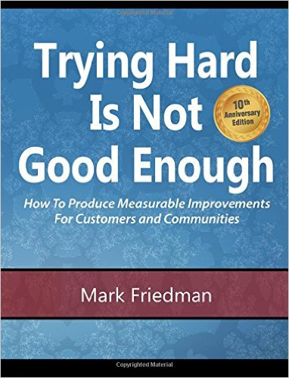
Ways to Manage by Data
Plan - Do – Check – Act
Results Based Accountability
Notes:
Different agencies are implementing similar, but often different approaches to measuring outcomes and monitoring performance in human service work. However, a few common approaches include the following. The one thing they all have in common is data.
Data should be used to determine what areas we want to act in, help us do the continuous quality checks and then determine what is working and what is not working. While the data that we provide online is likely not going to be specific enough to help you monitor what is working or not working – it can be used to help build the case for why something needs to be done.
RBA has been around for awhile in human services and seems to be implemented to some degree across the state now. If you have been trained in RBA then the exercise we have planned for the end of the session may look familiar. And again, our data will likely not be specific enough to monitor a specific intervention, but can be used to help show the “how much” and possibly even some of the outcomes.

Slide 8
Goal 2: Build Capacity and Promote Collaboration
Notes:
Rebecca: Goal 2 is focused on how FACT can support organizations and communities to build capacity and promote collaborative responses to family violence. One way FACT does this is through grant’s that are now given every 2 years.
The second way we achieve this is through our online research portal which will be the focus of the remainder of this presentation. I will now turn it over to Joyce who will highlight some specific ways in which FACT has and can support organizations.

Slide 9
Local Agency Perspective: Why is this resource helpful?
Capacity Building
Grants
Collaboration
Community Awareness/Education
Develop and Define Operational Practice

Slide 10
Capacity Building
The reports provide:
Insight into the community’s make-up
Framework to answer the resources that we have are adequate to be of value in providing the services
Targeted training is developed and coordinated to support the need
Monitor trends

Slide 12
Grants
These reports are useful:
To research a community’s conditions, trends, needs and compare to criteria set forth as a condition of eligibility for funding
To support answers to questions within the request for proposals within funding applications
Example – FACT grant

Slide 13
Long Term Outcome:
To Prevent Family Violence
The indicator this project will address is…
(Attachment B, Question 5)
CPS founded investigations of abuse and neglect of children
CPS completed family assessments
The goal of this project is to produce/provide…
(products or services, output)
Provide Darkness to Light’s Stewards of Children child abuse prevention training to 120-140 individuals through the coordination of eight community education/outreach forums from 7/1/14 to 6/30/15.
To…
(target of change)
To increase community members’ awareness of child abuse signs and symptoms, prevention strategies, and local resources.
So that they can…
(intermediate outcome)
Community members will be empowered to share in the protection of children by effectively identifying, responding to and reporting child abuse.
Resulting ultimately in…
(end outcome)
What is the desired outcome?
What is the end benefit to clients?
85% of community members participating in the Darkness to Light training will indicate an increased awareness of the local conditions that impact family and community-based violence as evidenced by a pre and post testing tool.
90% of community members participating in the Darkness to Light training will indicate an increased awareness of strategies to prevent child abuse and neglect as evidenced by a pre and post testing tool.
100% of community members participating in the Darkness to Light training will know how to report complaints of child abuse and neglect to the Virginia Department of Social Services state hotline, the local Department of Social Services and local law enforcement as evidenced by a pre and post testing tool.
100% of community members participating in the Darkness to Light training will sign an agreement to be a Steward for Children and commit to being proactive in protecting children as evidenced by the signed agreement.

Slide 14
Collaboration
Promoting collaborative partnerships and/or shared resources through the awareness of comparative data in other communities
Examples:
Consortiums/Peer Reviews
Collaborative trainings

Slide 15
Community Awareness and Education
We use the data from these reports:
To announce or advertise upcoming projects/trainings
To develop written resources
Market our services through data markers on Facebook and our website

Slide 17
Develop & Define Operational Practice
We have used the data:
To develop service flyers for internal use, to educate and motivate our team partners
Consideration of this data drives possible changes to policies/guidelines to meet the identified need or enhance our response to community and family-based violence

Slide 18
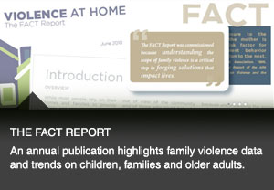
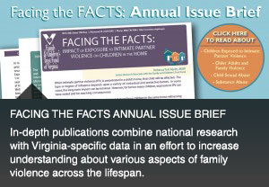
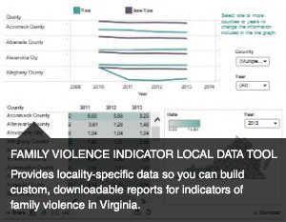
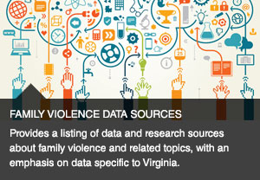
FACT Research Portal: Data Clearinghouse on Family Violence throughout Virginia
Notes:
Rebecca: Goal 1 also relates to the online research presence that we are discussing today. In just a moment I will jump into a live demonstration of the information we have online, but it includes the following domains.

Slide 19
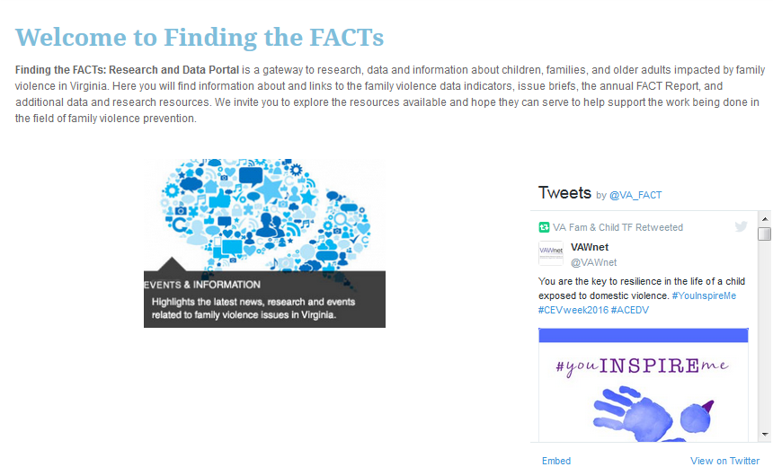
FACT Research Portal
http://www.fact.virginia.gov/finding-the-facts-research-and-data-portal/
Notes:
Rebecca: And now I will connect directly to the research portal, but have included the web address here for future reference.
Live demo –
Highlight the research portal

Slide 20
Data Analysis
http://www.publicprofit.net/Dabbling-In-The-Data
Categorizing
Simple Tallies

Slide 21
Applying the Data
How much? Is anyone better off?
http://resultsaccountability.com/workshops/
Group exercise

Slide 22
Communicating Your Findings
T-shirt activity
Dabbling in the Data
http://www.publicprofit.net/Dabbling-In-The-Data

Slide 24
Additional Support
Contact us with any questions or concerns!
http://www.fact.virginia.gov/finding-the-facts-research-and-data-portal/
Online webinar available: https://www.youtube.com/watch?v=Jh4s6hK1qLw&noredirect=1
Step-by-step guide: http://www.fact.virginia.gov/wp-content/uploads/2015/01/Step-by-Step.pdf
Notes:
Rebecca: Note all of these resources for future reference if there are any questions that arise.
Nicole: Wrap-up

Slide 25
Stay Connected
Follow us on Twitter, like us on Facebook, catch us on YouTube and signup to stay current with the latest news and updates with our Newsletter
@VA_FACT
FACTVA
http://www.fact.virginia.gov
Nicole Poulin
Nicole.Poulin@dss.virginia.gov
804.726.7604
Rebecca Hjelm
Rebecca.hjelm@dss.virginia.gov
804.726.7954
Joyce Moran
jmoran@southernvacac.org
540.484.5566

